Slide 1
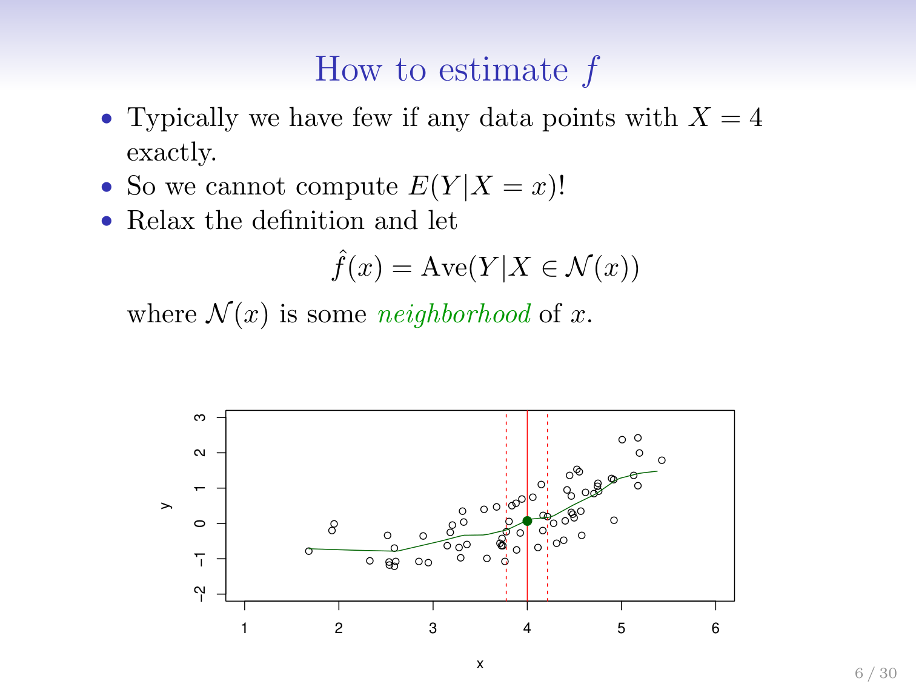

Slide 2
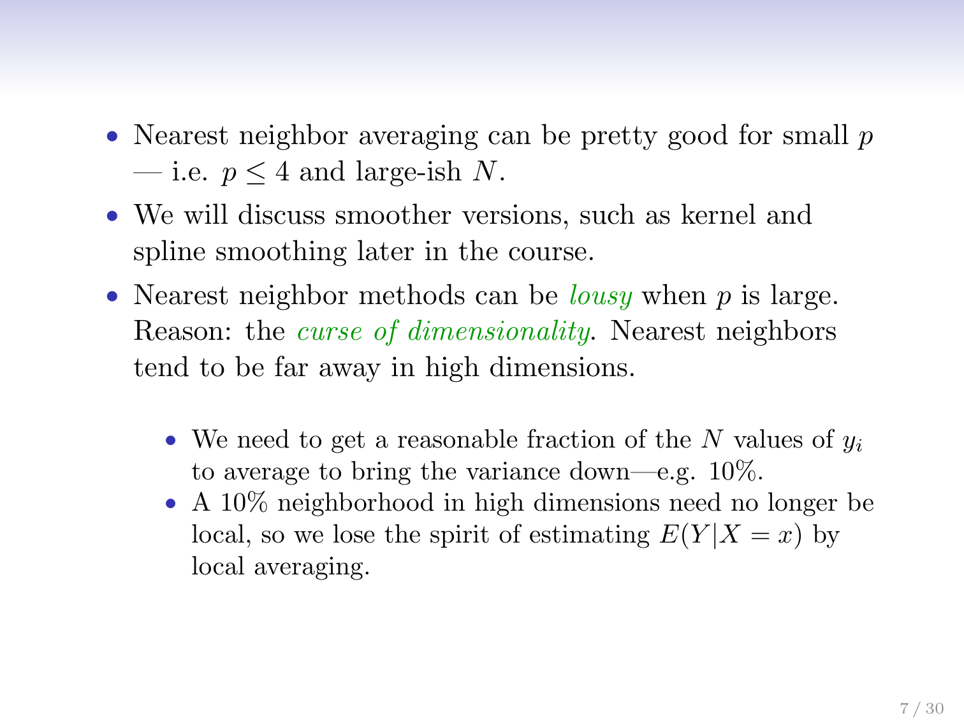
Notes:
Thin Spline – Explained Later

Slide 3
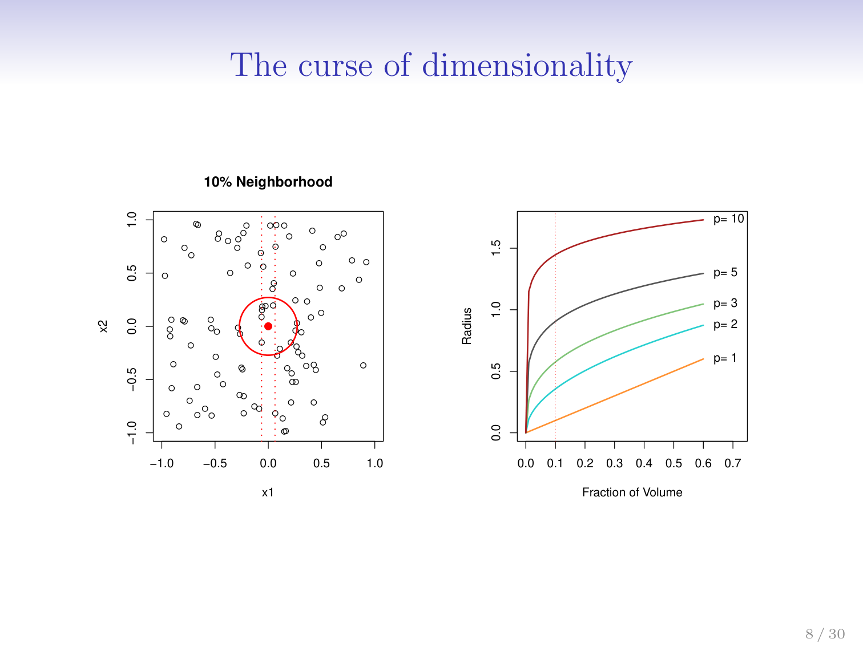

Slide 4
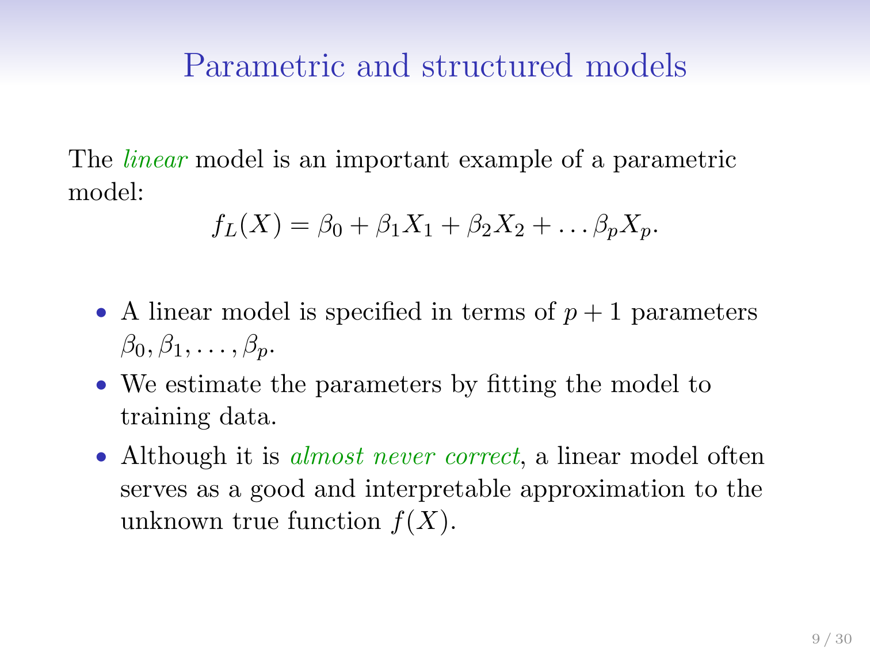

Slide 5
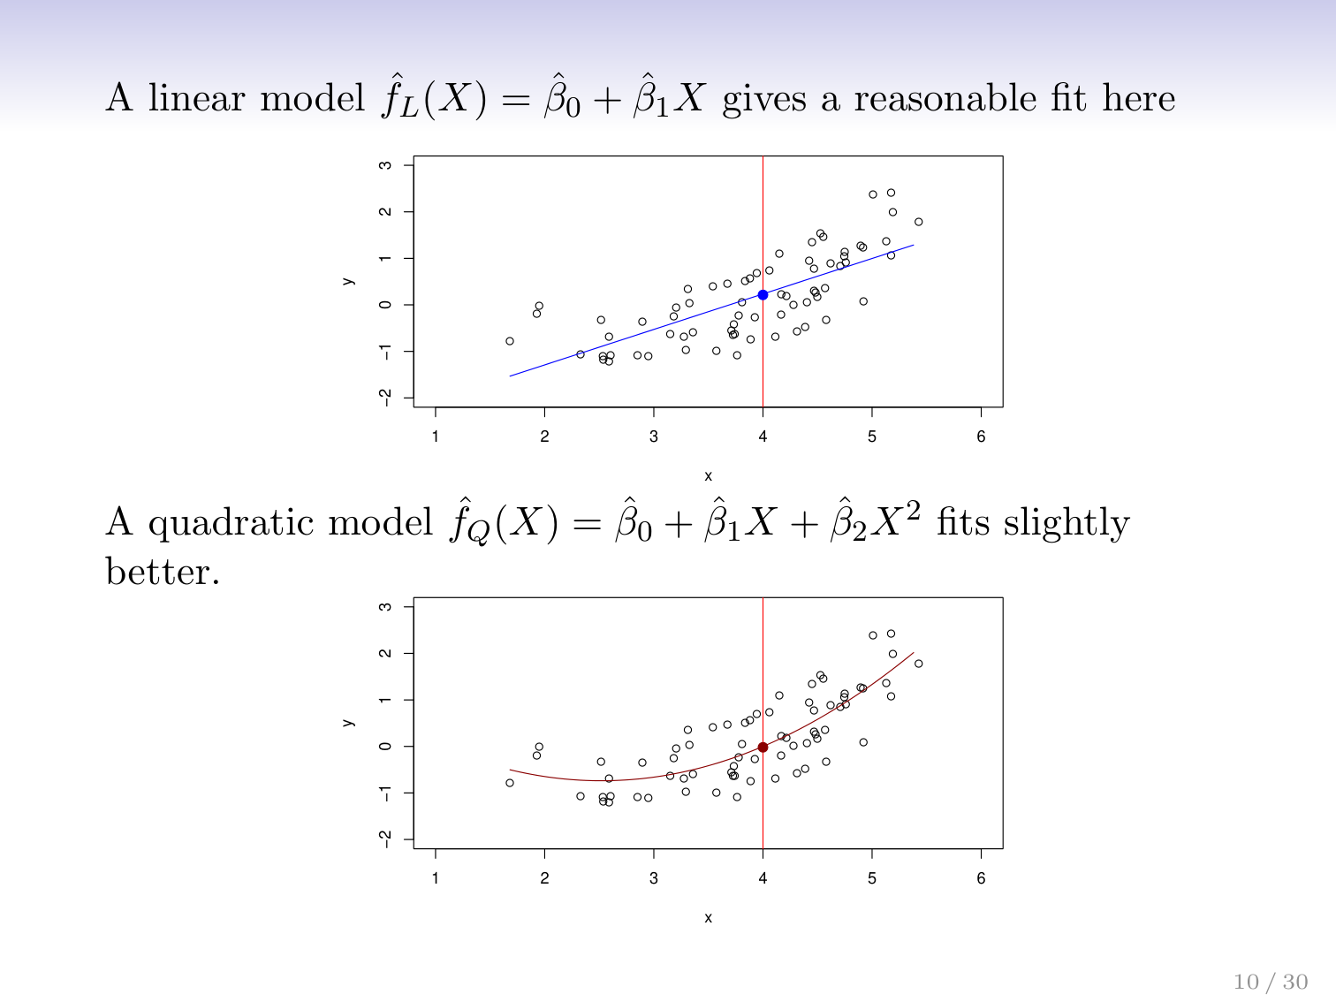

Slide 6
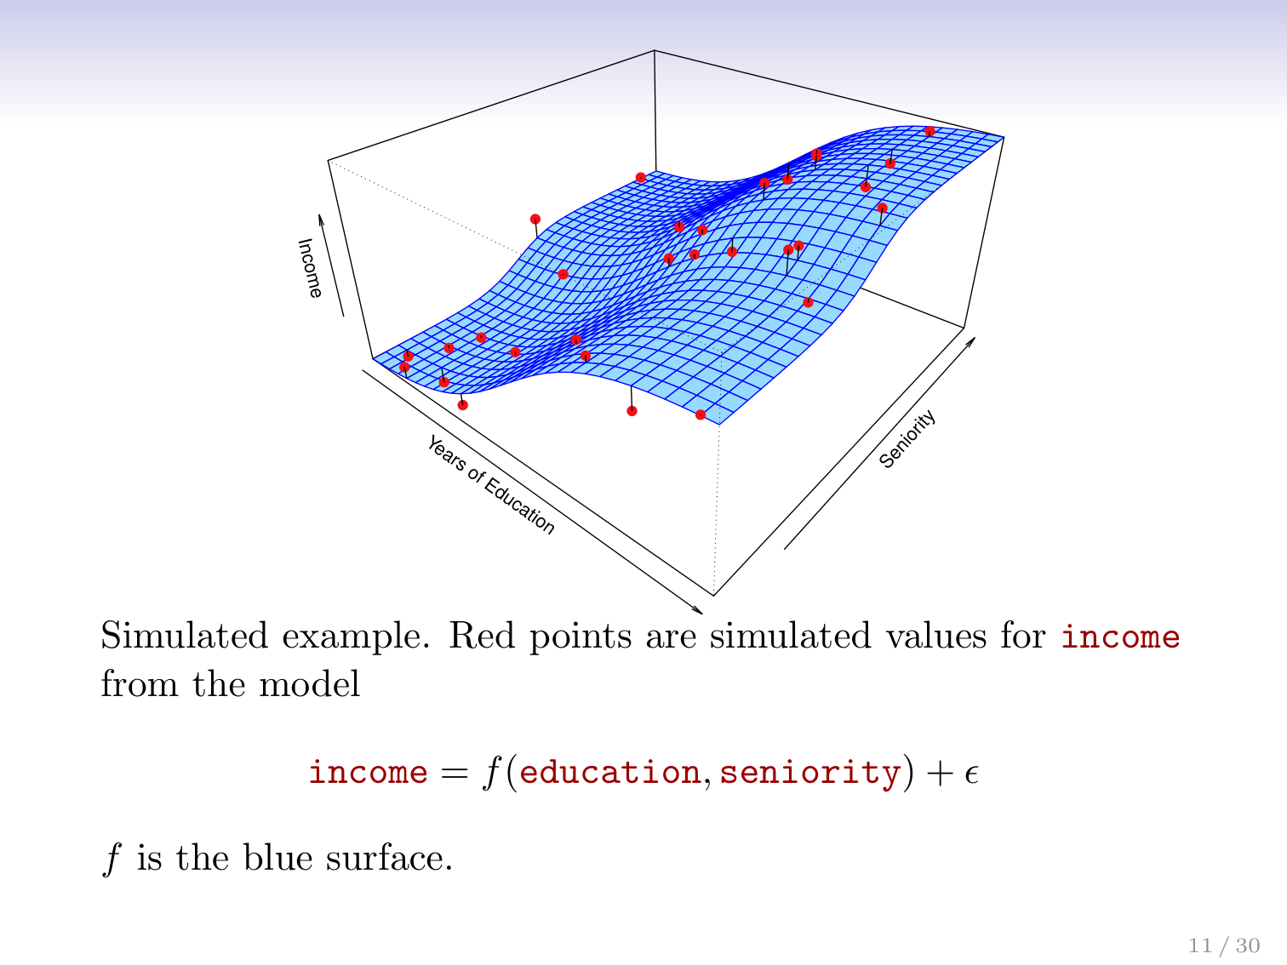

Slide 7
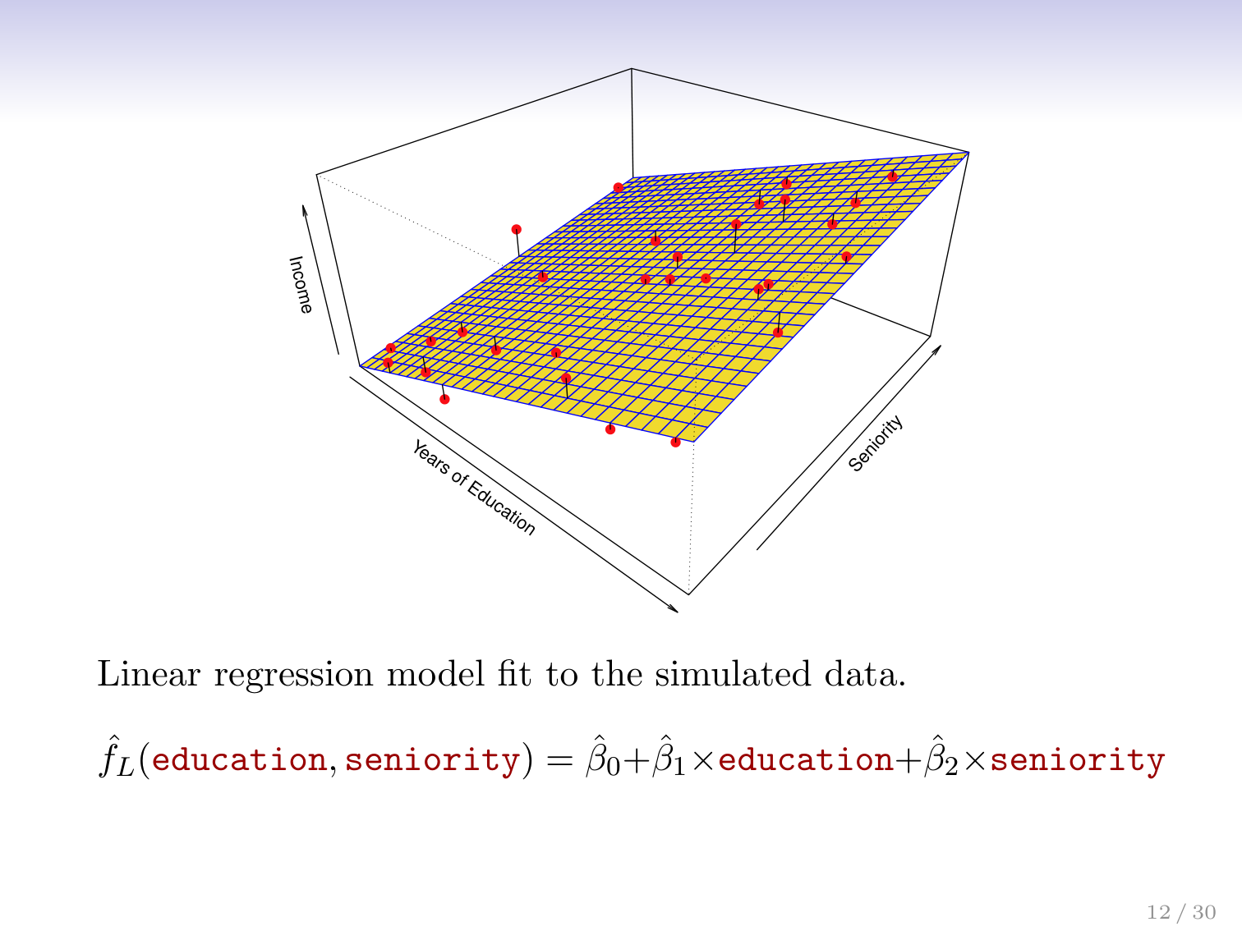

Slide 8
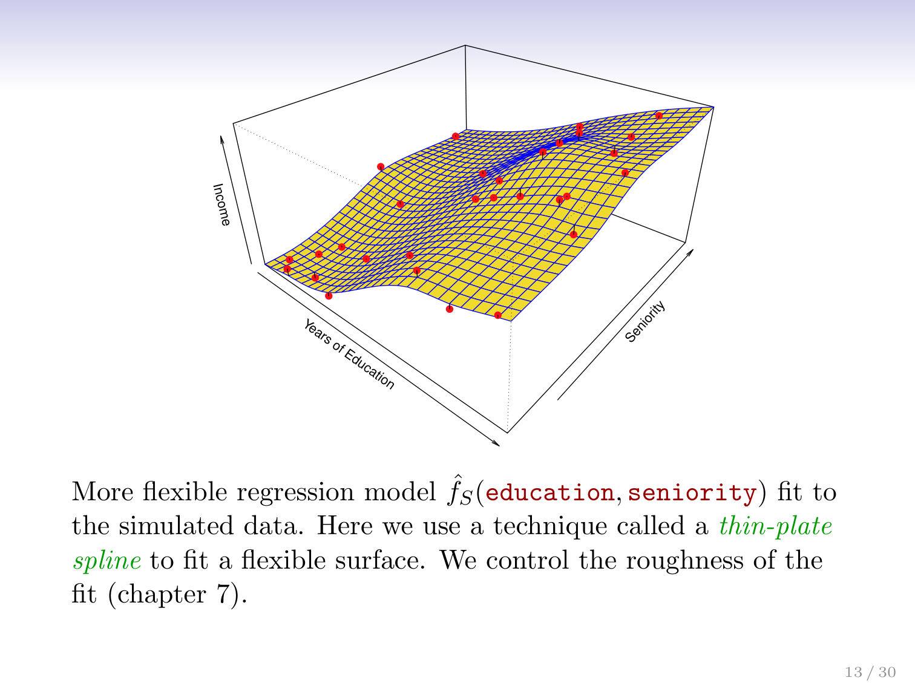

Slide 9
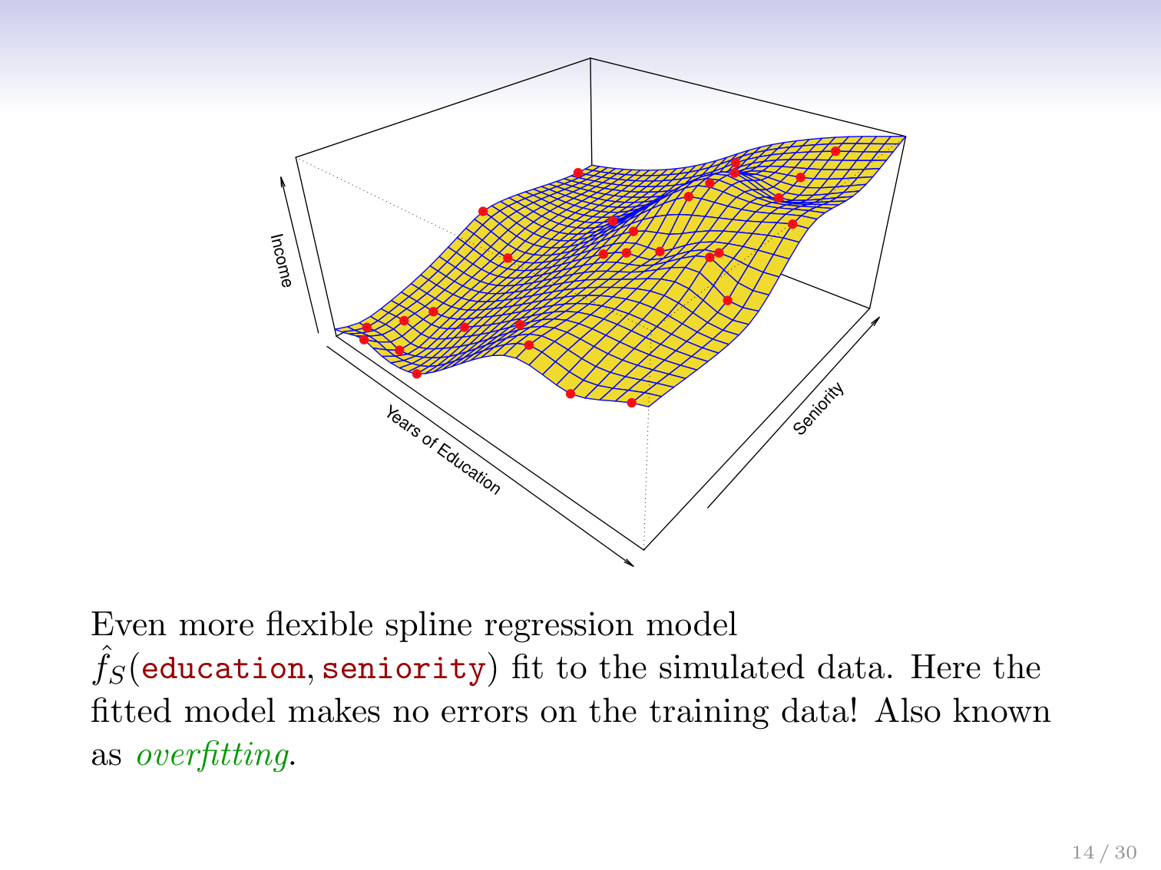

Slide 10
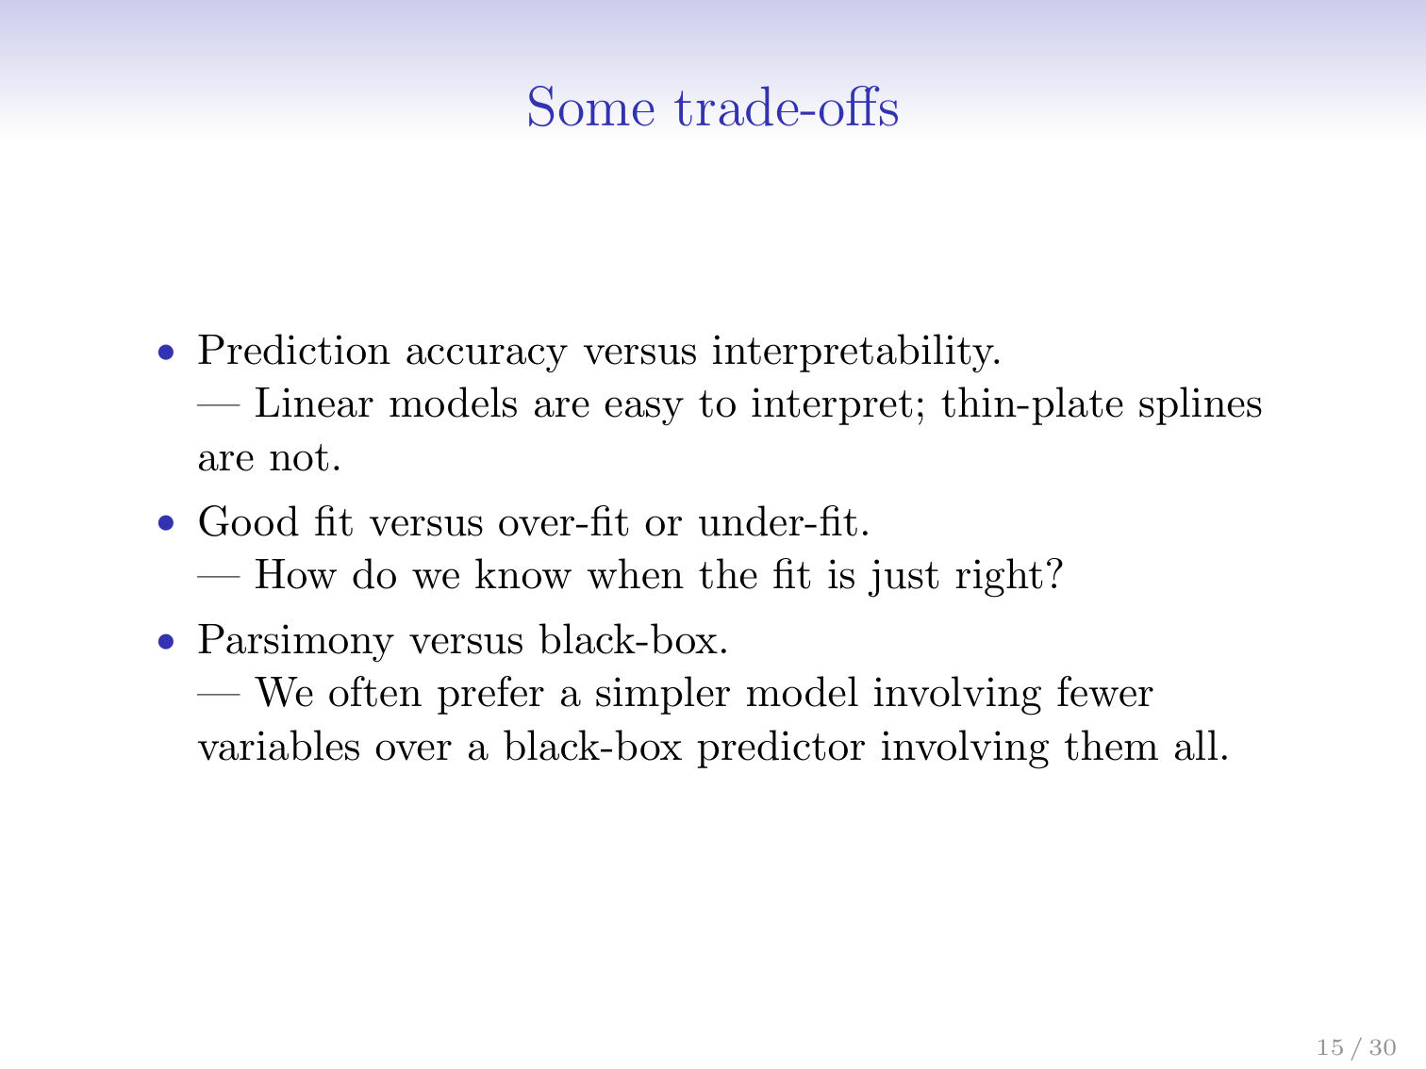

Slide 11
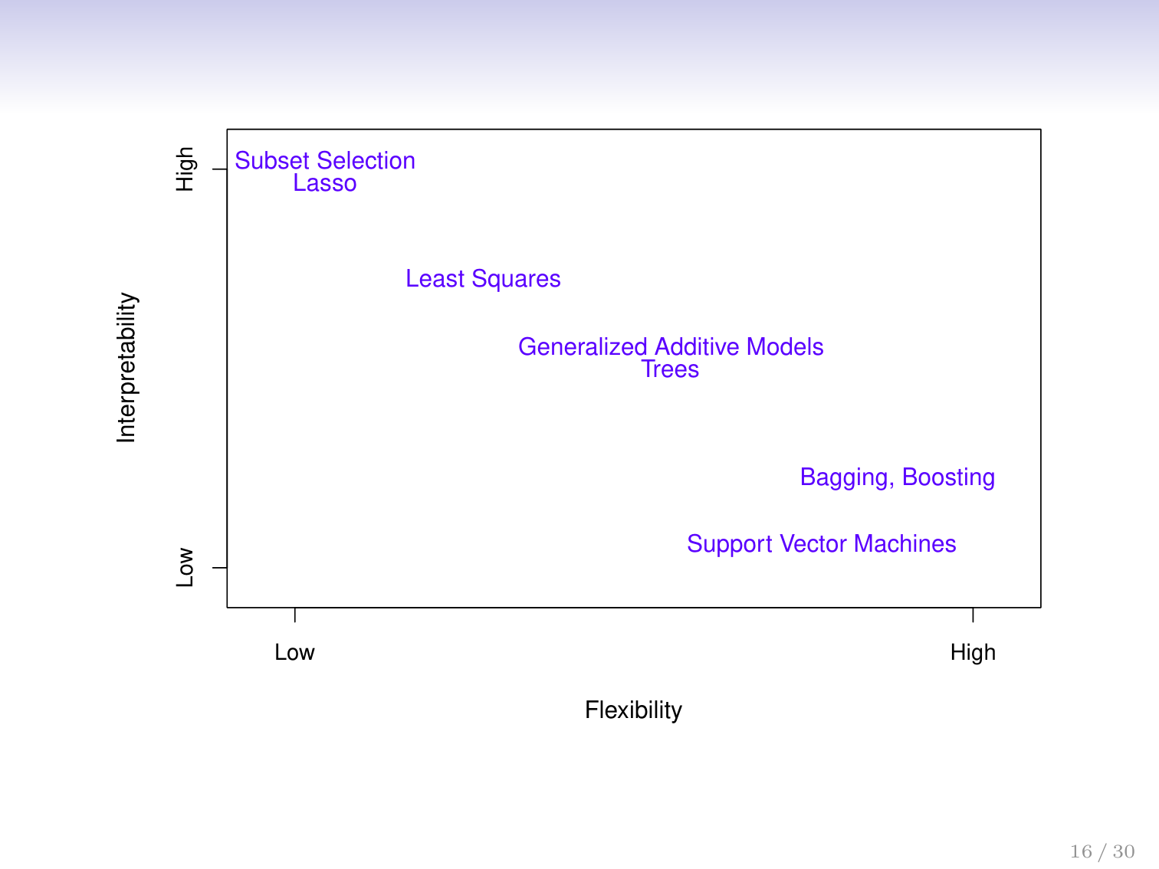

Slide 12
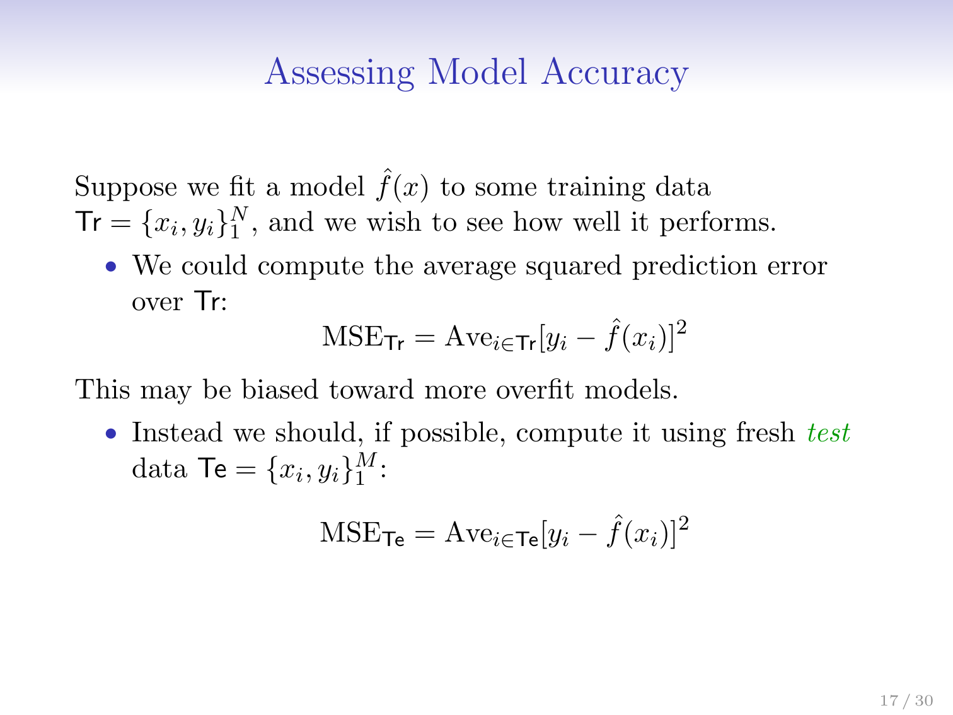
Notes:
Mean Squared error is tha average value of the differences between the predicted and the actual. So X at 7 based on the regression line gives you a vlue of 8 for y but its actually 6. its 2 off which you square to ensure a positive number and take average of all results of other X’s

Slide 13
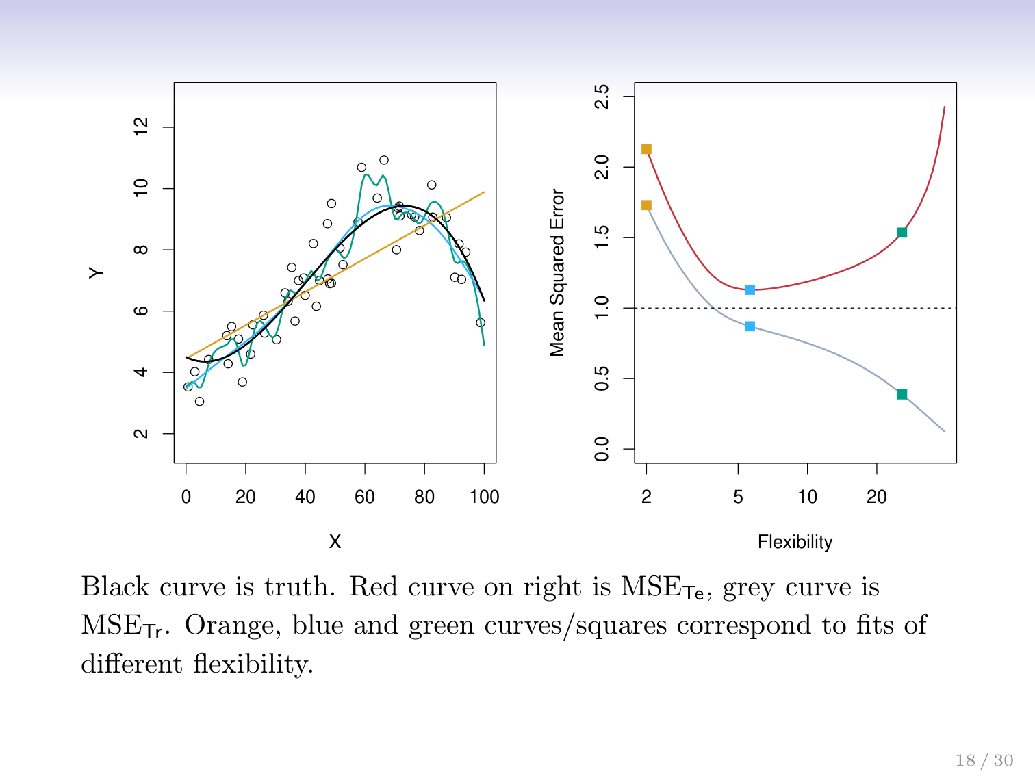

Slide 14
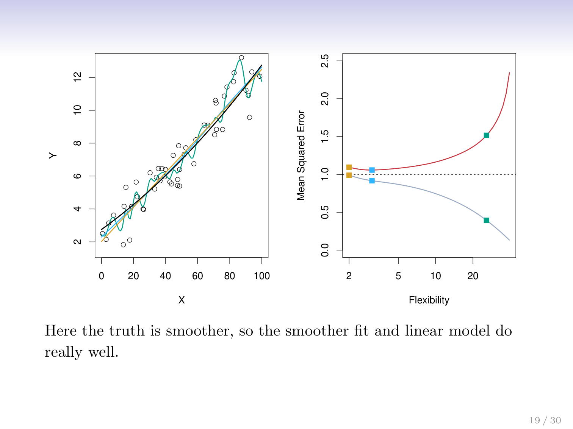

Slide 15
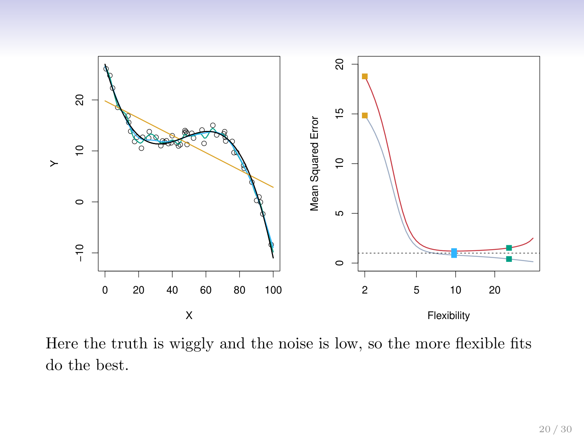

Slide 16
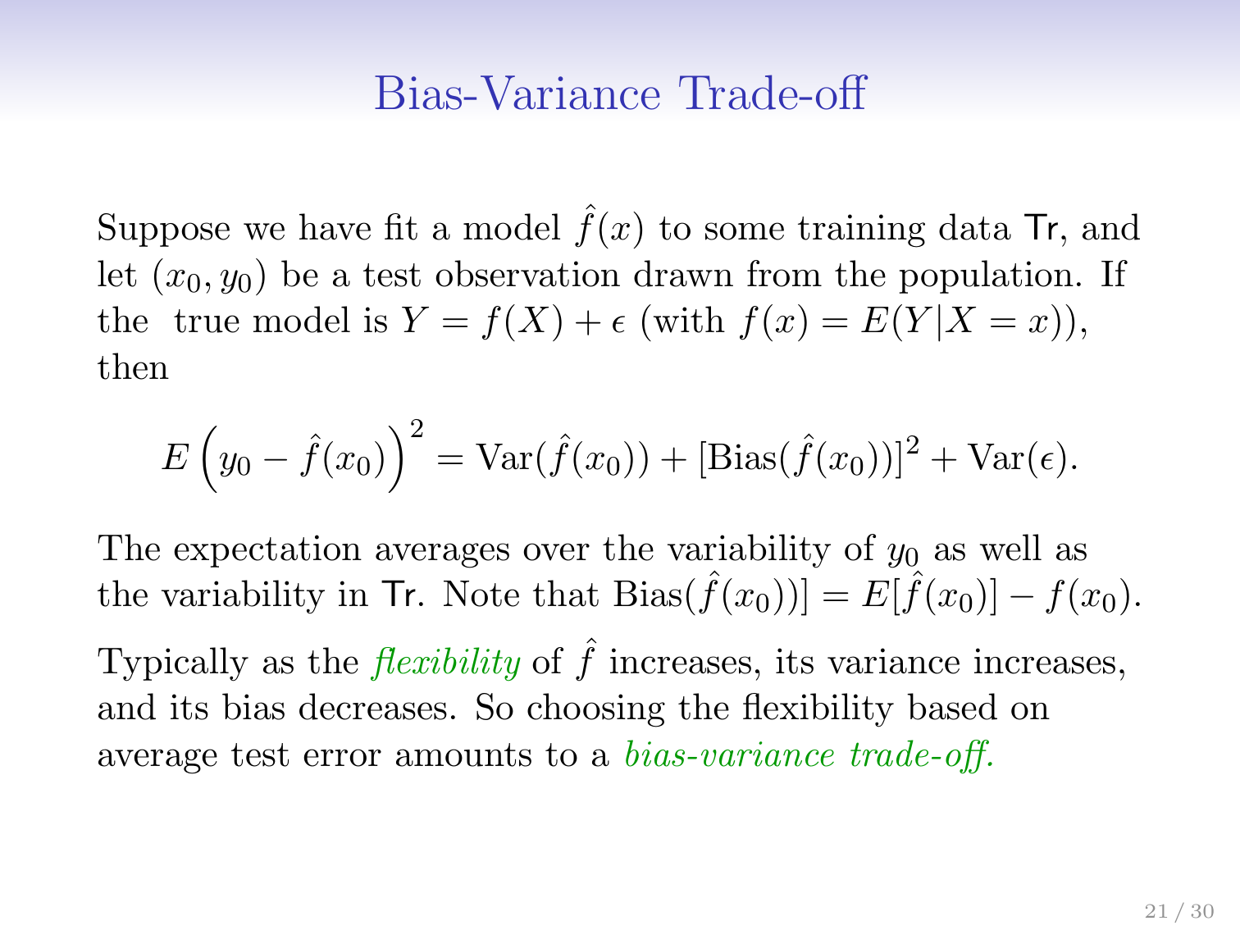
Notes:
Bias is the inherent bias of an algorithm to not be able to model the data pattern. If relationship is not linear then lin regression will suffer.
Variance will be how different the outcomes will be for an algorithm using different training data points
You want to trade these off against each other so that you have a model flexible enough to capture the functionof the data but without over fitting too much to make it less predictive

Slide 17
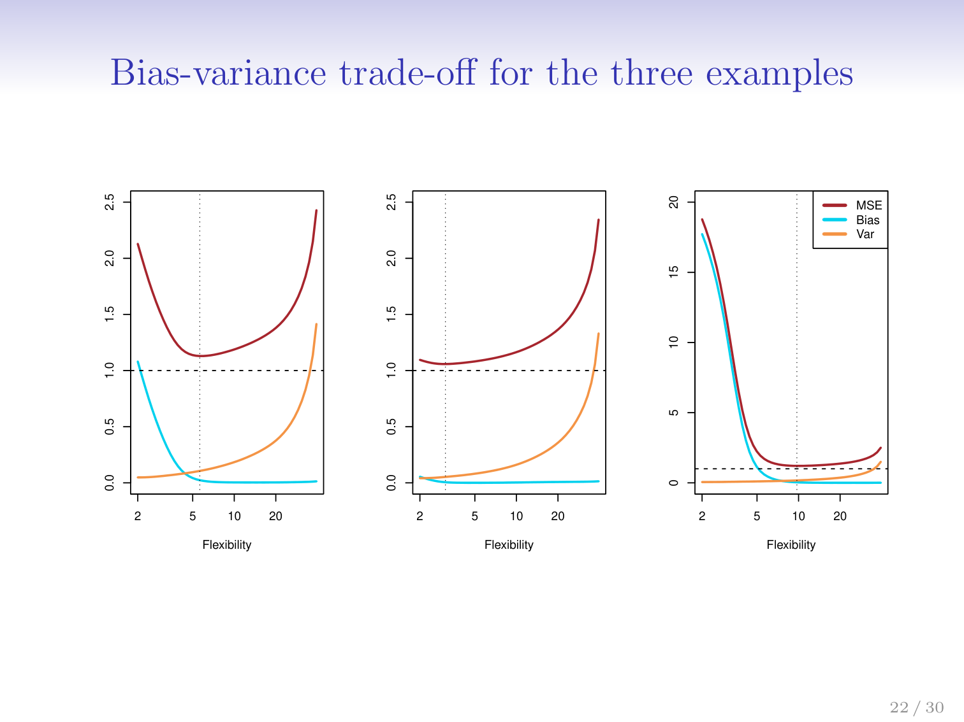

Slide 18
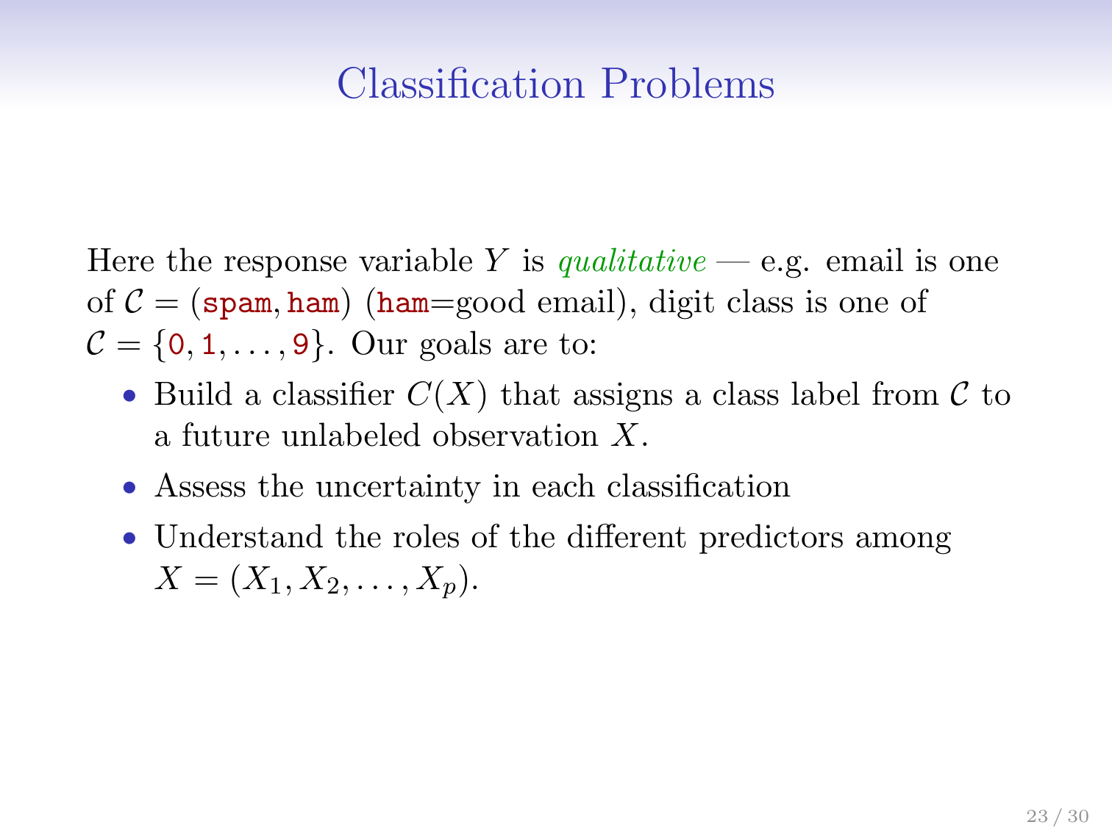

Slide 19
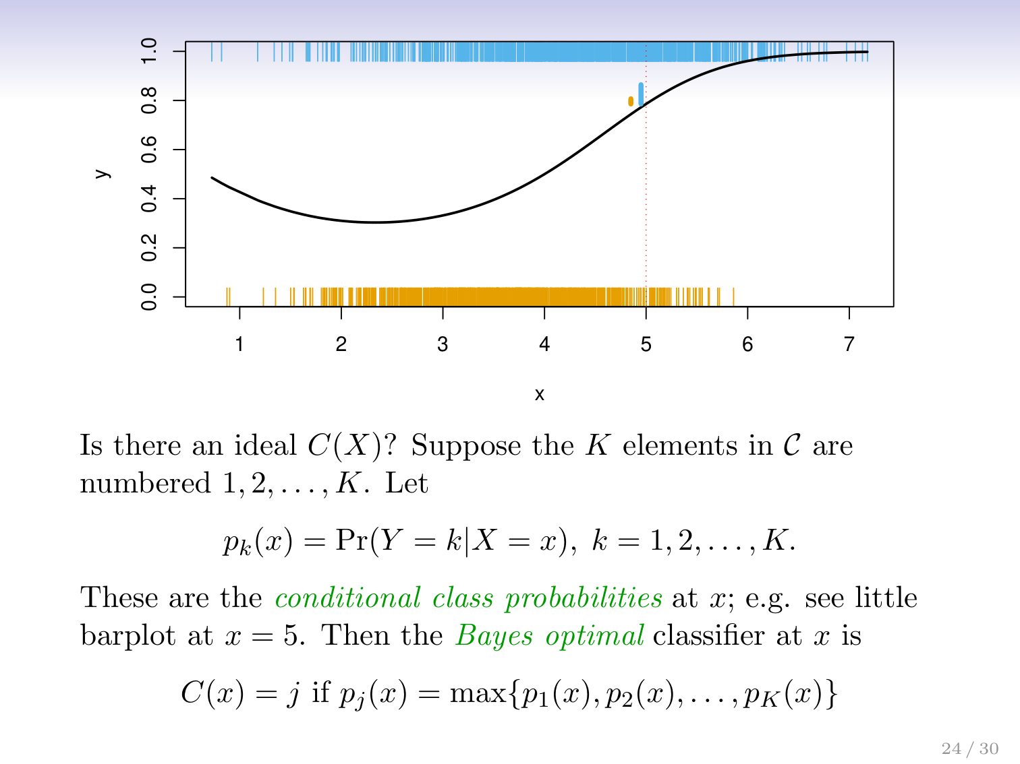
Notes:
Based on the training here you are calculating the probability of which class at each point so that a new prediction just looks at the point you arte predicting for and finds out how many blues are vs how many yellows and determines a probability of which it is based on those proportions. The line represents it above

Slide 20
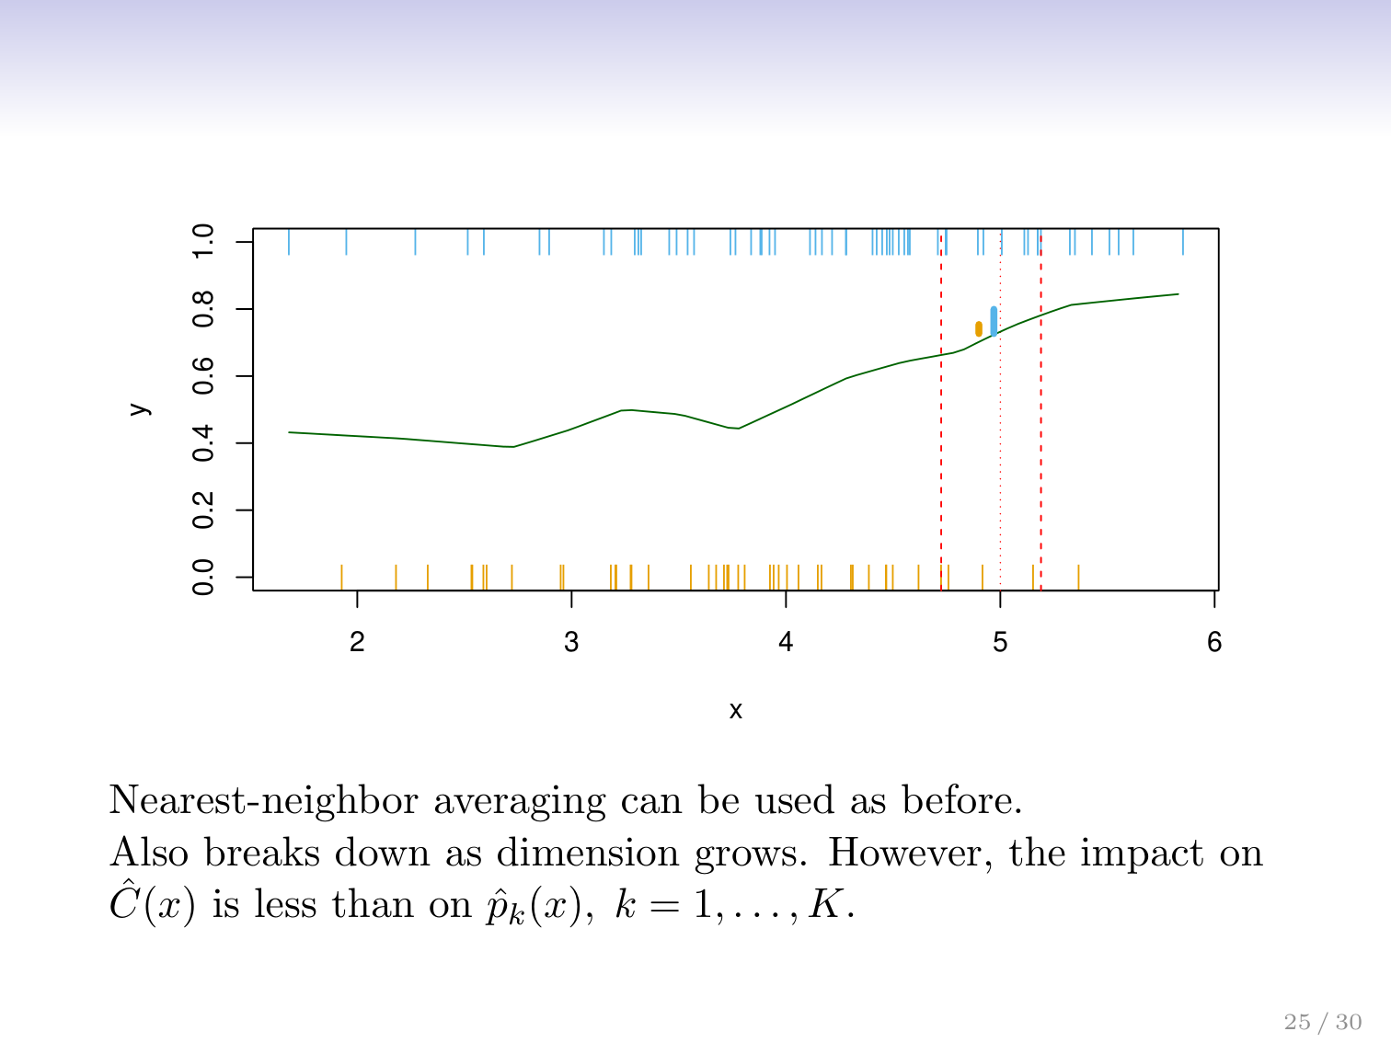

Slide 21
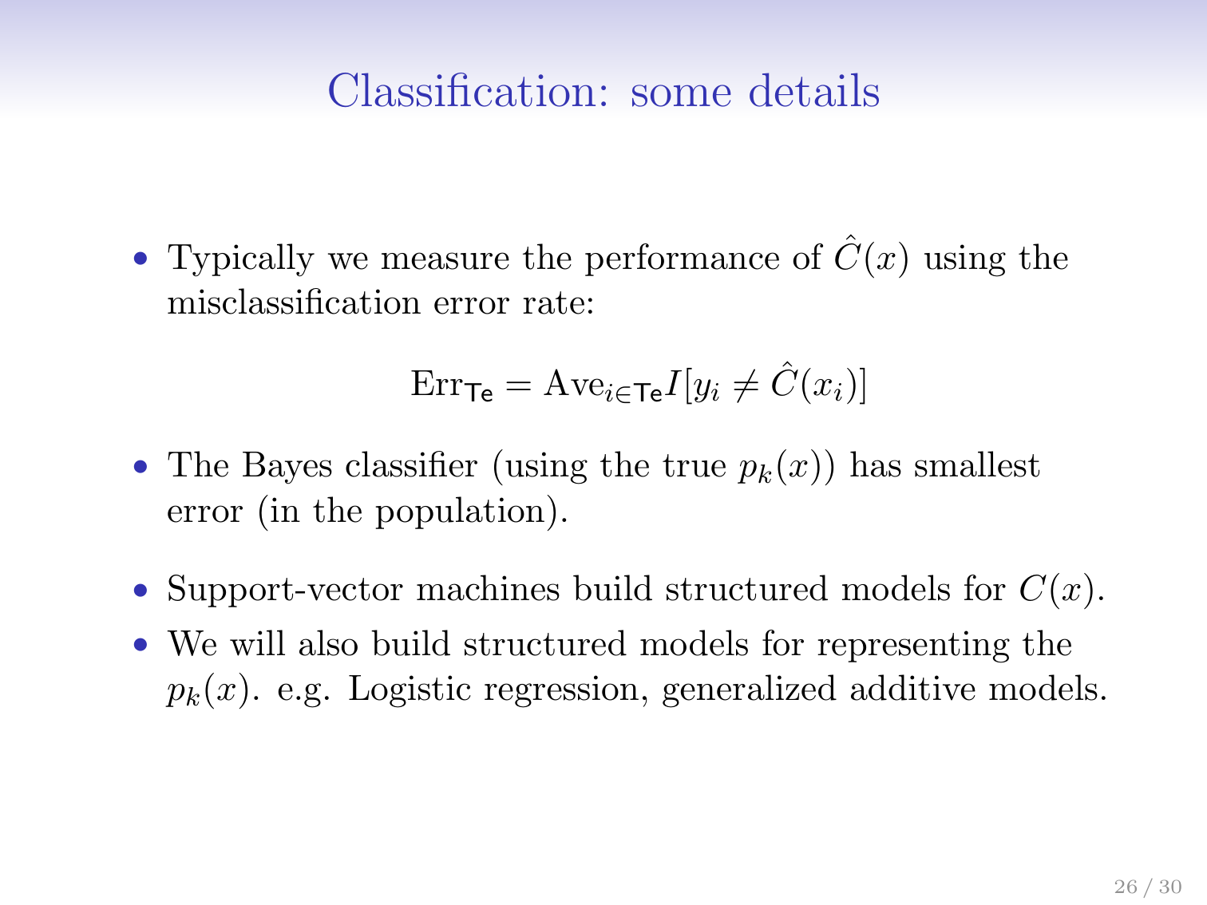

Slide 22
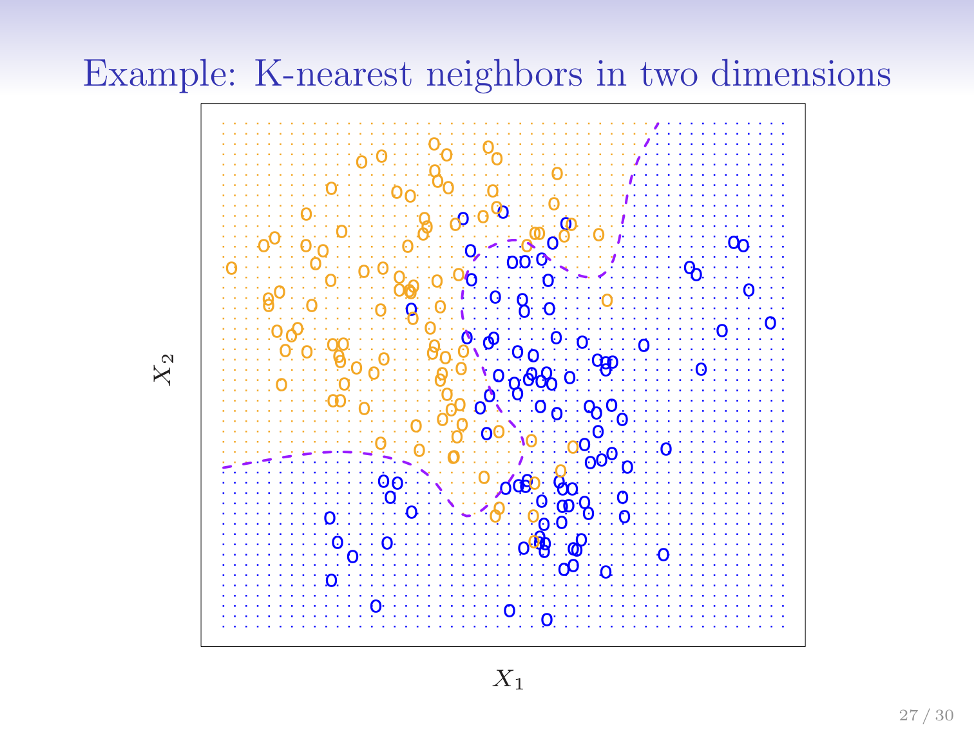

Slide 23
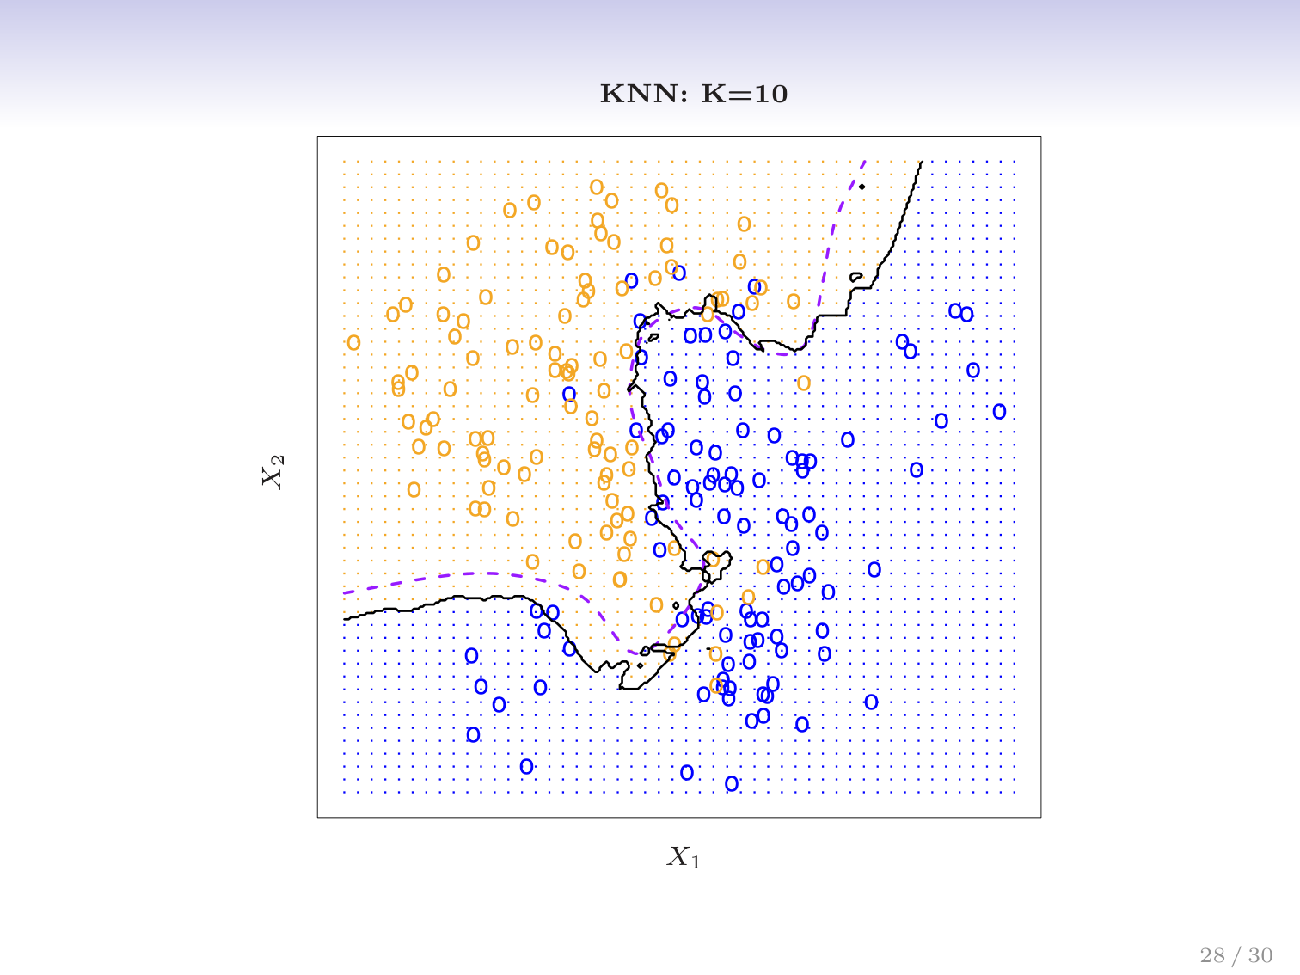

Slide 24
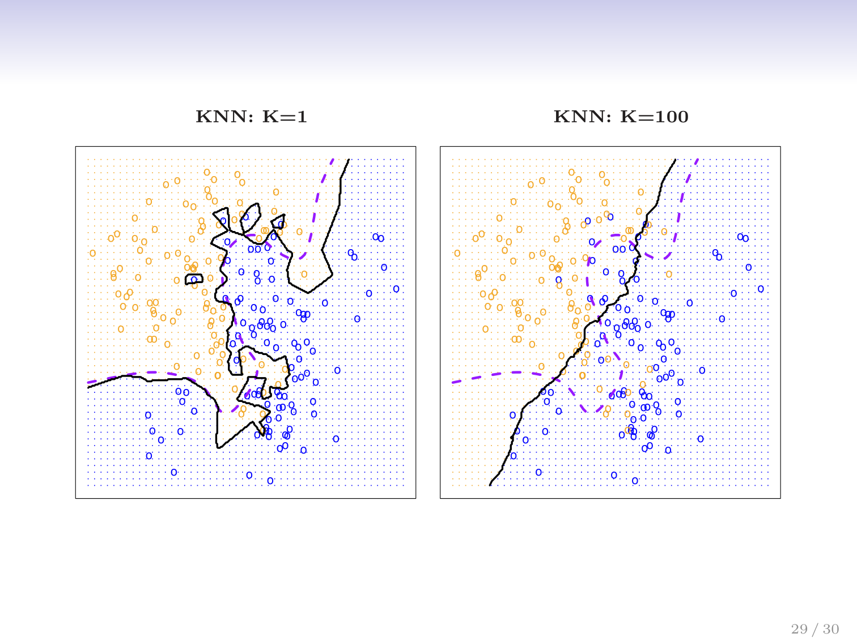
Notes:
Here the K = 100 is crap because its needing to take in the nearest 100 points which give you too much area to generate an average for. You want to look closer to home like in k=1. (nearest neighbour is effective in 1/3 problems apparently)

Slide 25
